Slide 1
Otodom Analysis
Poland house market analysis.
Rent or Buy?
A Project by: Murli Nishant Kumar

Slide 2

Description
Welcome to a comprehensive guide on the housing market in Poland! Whether you're a new mover or someone interested in buying a house in this beautiful country. This analysis, will answer all the major questions you might have, providing you with valuable insights and information.

Slide 3




Technicality
To completely transform the data, google sheets and its api were used to convert text from Polish to English.
Snowflake’s cloud-based data storage and analytics service along with snowsql were used to transform and find insights.
Dataset used in this analysis was acquired from a very trusted online source called Brightspace.
Python was used to transform the house address provided in the dataset from to Longitude and Latitude to readable human language.
This Photo by Unknown Author is licensed under CC BY-SA

Slide 4
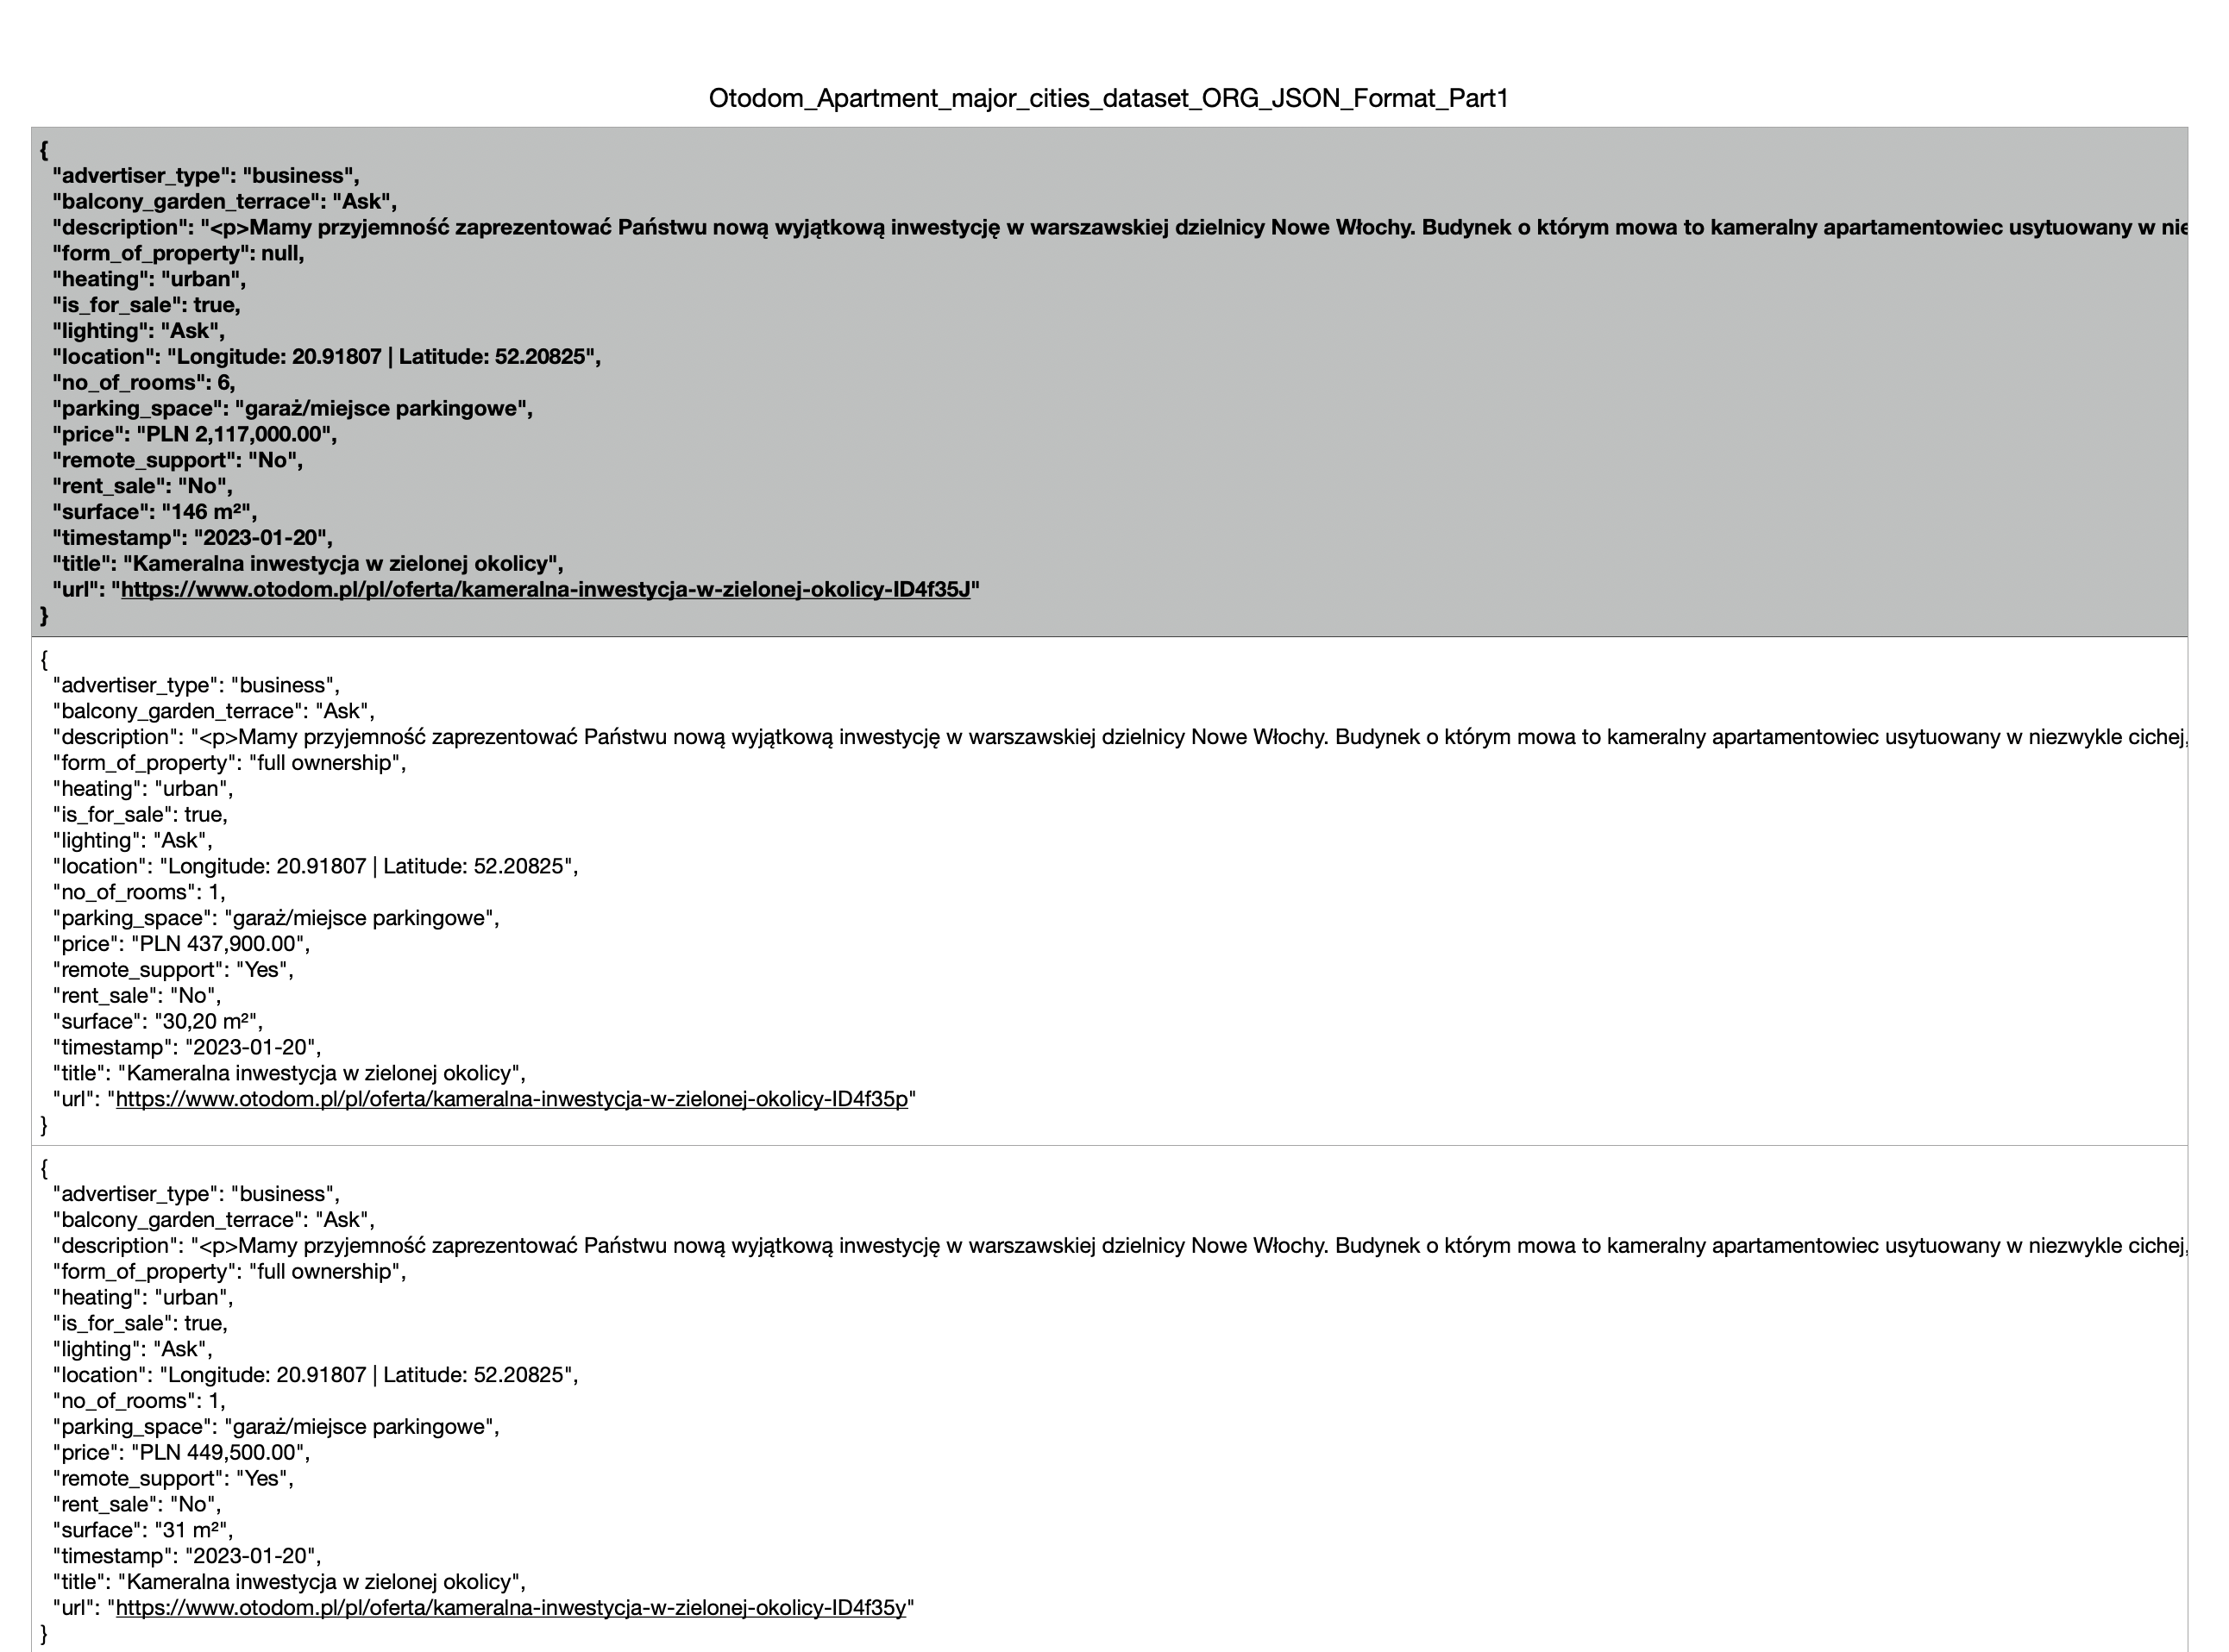
Data Transformation
Pre-TRANSFORMATION
Initially all the date acquired form Brightspace was in Json format.
Description column was in Polish.
Location was in LONGITUDE AND LATITUDE format.
Contained special characters.
Null entries on few cells.

Slide 5
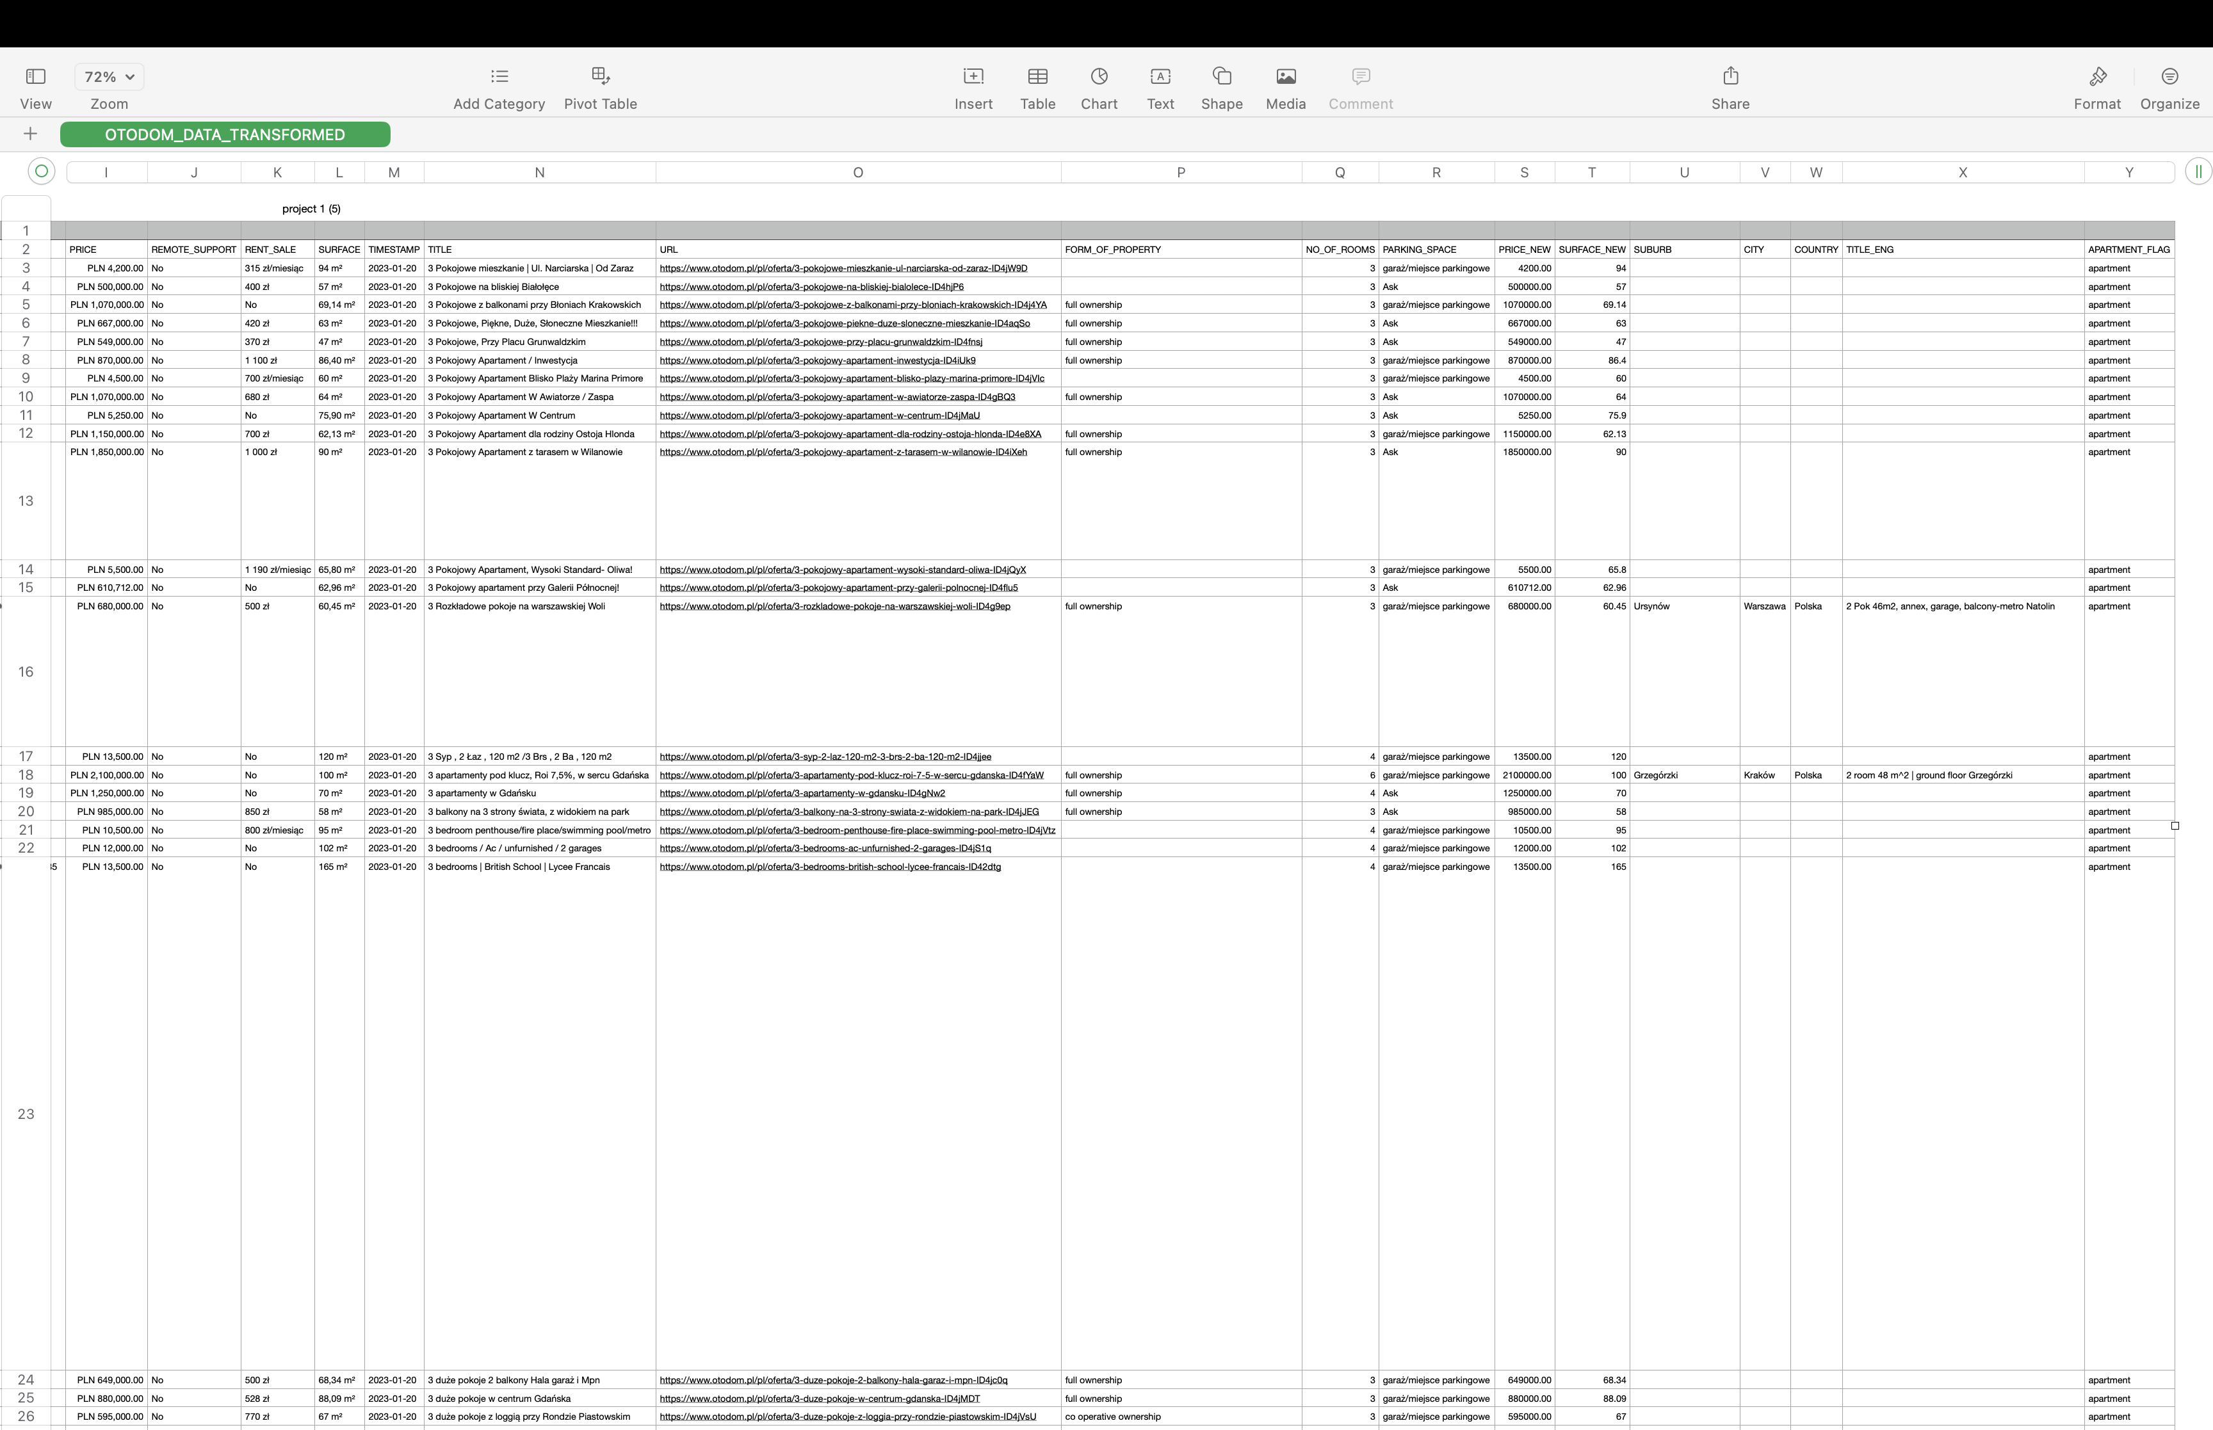
Data Transformation
POST-TRANSFORMATION
Table was organized and error free.
Json was converted into a csv file format
Description column was translated into English.
Longitude and Latitude was converted into proper addressed using geopy.
Unnecessary null values and special characters were removed.

Slide 6
PROBLEM STATEMENT &SOLUTIONS
In this housing market analysis, I have answered 11 of the most important question which are solved and discussed in the next few slides, along with SQL query and visuals where required.
Datasets provide in the repository contain 68k records and final tables named as OTODOM_DATA_TRANSFORMED is the final transformed table used for analysis.

Slide 7
1. What is the average rental price of 1 room, 2 room, 3 room and 4 room apartments in some of the major cities in Poland? Arrange the result such that avg rent for each type of room is shown in separate column.
select city, round(avg_rent_1R,2) as avg_rent_1R
, round(avg_rent_2R,2) as avg_rent_2R, round(avg_rent_3R,2) as avg_rent_3R
, round(avg_rent_4R,2) as avg_rent_4R
from (
select city,no_of_rooms,price_new
from otodom_data_transformed
where city in ('Warszawa', 'Wrocław', 'Kraków', 'Gdańsk', 'Katowice', 'Łódź')
and apartment_flag = 'apartment'
and is_for_sale='false'
and no_of_rooms in (1,2,3,4)) x
pivot
(
avg(price_new)
for no_of_rooms in ('1','2','3','4')
)
as p(city,avg_rent_1R, avg_rent_2R, avg_rent_3R, avg_rent_4R)
order by avg_rent_4R desc;

Slide 8
Answer:
CITY | AVG_RENT_1R | AVG_RENT_2R | AVG_RENT_3R | AVG_RENT_4R
Łódź | 2563.21 | 3298.15 | 5921.44 | 9946.43
Gdańsk | 2343.50 | 3370.59 | 5176.25 | 9846.30
Wrocław | 2286.09 | 3385.39 | 4542.59 | 8735.23
Warszawa | 2552.39 | 3499.38 | 5229.34 | 8676.33
Kraków | 2537.82 | 3308.44 | 5417.83 | 8251.05
Katowice | 2142.38 | 3676.70 | 5355.60 | 7768.75

Slide 9
2. I want to buy an apartment which is around 90-100 m2 and within a range of 800,000 to 1M, display the suburbs in warsaw where I can find such apartments.
select suburb, count(1), avg(price_new) avg_price
from otodom_data_transformed
where city in ('Warszawa')
and apartment_flag = 'apartment'
and is_for_sale = 'true'
and surface_new between 90 and 100
and price_new between 800000 and 1000000
group by suburb
order by count(1) desc;
Note: For all the sql queries please find the attached pdf in the repository.

Slide 10
Answer:
SUBURB | COUNT(1) | AVG_PRICE
Praga-Południe | 6 | 888633.16666667
Bielany | 5 | 893200.00000000
Mokotów | 4 | 916087.50000000
Ursus | 4 | 871110.75000000
Wola | 3 | 929333.33333333
Białołęka | 3 | 929333.33333333
Bemowo | 3 | 932666.66666667
Włochy | 3 | 917530.00000000
Wilanów | 2 | 895000.00000000
Ursynów | 2 | 878210.00000000
 | 1 | 864000.00000000
Wawer | 1 | 928000.00000000
Targówek | 1 | 915000.00000000

Slide 11
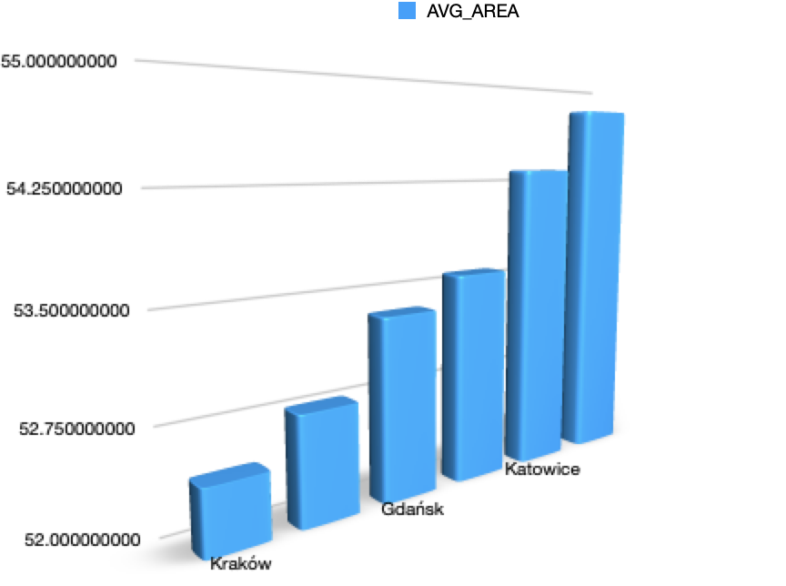
3. What size of an apartment can I expect with a monthly rent of 3000 to 4000 PLN in different major cities of Poland?
CITY | AVG_AREA
Kraków | 52.464285714
Wrocław | 52.790227273
Gdańsk | 53.349923664
Łódź | 53.578450704
Katowice | 54.3325
Warszawa | 54.803481481

Slide 12
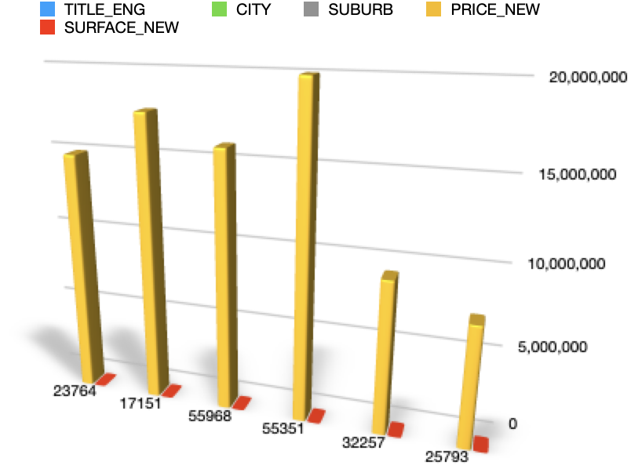
4. What are the most expensive apartments in major cities of Poland? Display the ad title in English along with city, suburb, cost, size.
RN | TITLE_ENG | CITY | SUBURB | PRICE_NEW | SURFACE_NEW | URL
23764 | 2pok in Śródmieście, very close to the old town | Gdańsk | Śródmieście | 15000000.00 | 350 | https://www.otodom.pl/pl/oferta/dom-350-m-warszawa-ID4eb1H
17151 | 2-room apartment 42m2 + loggia without commission | Katowice | Koszutka | 17720000.00 | 226 | https://www.otodom.pl/pl/oferta/apartament-fort-cze-z-tarasem-na-dachu-500m2-ID4jNhn
55968 | Apartment in a representative tenement house! | Kraków | Grzegórzki | 16000000.00 | 560 | https://www.otodom.pl/pl/oferta/ultra-nowoczesny-dom-wykonczony-pod-klucz-ID4hXp1
55351 | Delux apartment in the heart of Powiśle | Warszawa | Wesoła | 20000000.00 | 577 | https://www.otodom.pl/pl/oferta/topowa-lokalizacja-apartament-z-basenem-ID4iZEj
32257 | 3-room apartment 55m2 + 2 gardens | Wrocław | Przedmieście Oławskie | 9450000.00 | 349 | https://www.otodom.pl/pl/oferta/ks-witolda-cale-10-pietro-penthouse-350mkw-ID4im01
25793 | 3 rooms 2 20m2 balconies ideal for investments. | Łódź | Łódź-Polesie | 7500000.00 | 570 | https://www.otodom.pl/pl/oferta/ekskluzywna-willa-obok-lasku-wolskiego-ID4iLkz

Slide 13

5. What is the percentage of private & business ads on Otodom?
Answer:

Slide 14
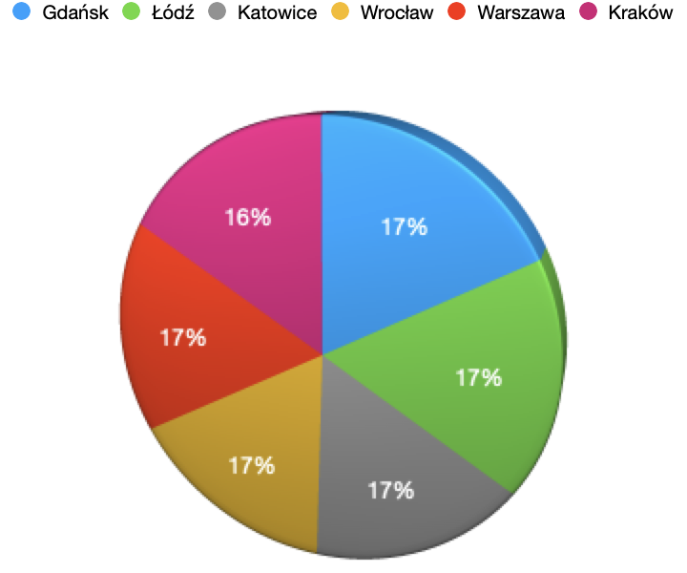
6. What is the avg sale price for apartments within 50-70 m2 area in major cities of Poland?
CITY | AVG_SALE_PRICE
Gdańsk | 666452.44
Łódź | 656937.92
Katowice | 649845.75
Wrocław | 649449.23
Warszawa | 649204.64
Kraków | 634435.57

Slide 15
7. What is the average rental price for apartments in warsaw in different suburbs? Categorize the result based on surface area 0-50, 50-100 and over 100.
SUBURB | AVG_PRICE_UPTO_50 | AVG_PRICE_UPTO_100 | AVG_PRICE_OVER_100
Bemowo | 2395.90 | 5466.73 | 14277.41
Ursus | 2737.28 | 4725.64 | 14035.39
Białołęka | 2656.98 | 4653.86 | 12150.57
Żoliborz | 2017.40 | 4116.67 | 5000.00
Wola | 2761.51 | 5051.66 | 10194.67
Śródmieście | 2931.13 | 4655.97 | 9481.25
Włochy | 2715.41 | 5374.26 | 10342.26
Praga-Północ | 2802.78 | 4460.63 | 10352.70
Wilanów | 2587.50 | 5008.38 | 14150.67
Targówek | 2533.81 | 5657.36 | 12878.00
Wesoła | 3050.00 | 5628.50 | 21000.00
Bielany | 2902.58 | 5281.36 | 10936.17
Ursynów | 2791.55 | 5951.30 | 15605.67
Rembertów | 0.00 | 5460.00 | 6565.00
Praga-Południe | 3063.21 | 4824.95 | 13734.78
Mokotów | 2515.78 | 5566.98 | 12678.30
Wawer | 1777.78 | 5452.14 | 15510.00

Slide 16
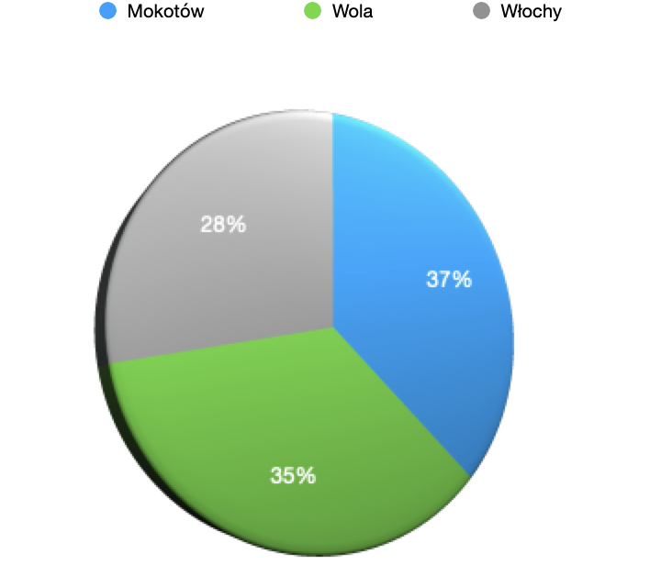
8. Which are the top 3 most luxurious neighborhoods in Warsaw? Luxurious neighborhoods can be defined as suburbs which has the most no of of apartments costing over 2M in cost.
SUBURB | LUXURIOUS_APARTMENTS
Mokotów | 33
Wola | 31
Włochy | 25

Slide 17
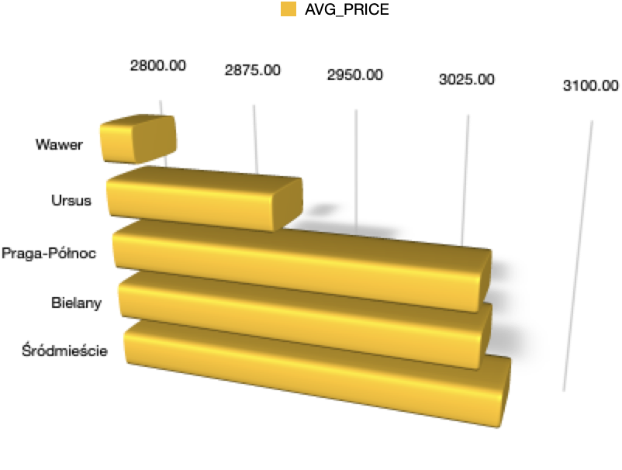
9. Most small families would be looking for apartment with 40-60 m2 in size. Identify the top 5 most affordable neighborhoods in warsaw.
SUBURB | AVG_PRICE | NO_OF_APARTMENTS
Wawer | 2824.00 | 10
Ursus | 2919.18 | 22
Praga-Północ | 3047.96 | 9
Bielany | 3050.50 | 18
Śródmieście | 3065.15 | 27

Slide 18
10. Which suburb in Warsaw has the most and least no of private ads?
LEAST_PRIVATE_ADS | MOST_PRIVATE_ADS
Wesoła - 1 | Wola - 82

Slide 19
11. What is the average rental price and sale price in some of the major cities in Poland?
CITY | AVG_RENTAL | AVG_SALE
Wrocław | 5897.40 | 871702.82
Kraków | 5763.27 | 854240.42
Łódź | 5737.53 | 811999.66
Warszawa | 5523.57 | 855782.52
Gdańsk | 5330.29 | 850221.14
Katowice | 5140.42 | 943282.38

Slide 20
Conclusion
There are various properties to rent and buy in different cities in Poland depending on the budget and other important needs of a buyer.
Otodom is a property listing website of Poland this detailed analysis all the market trends and answers all the important questions.
A Project by: Murli Nishant Kumar

